Slide 1
How to conduct a research to evaluate the MBTI of LLMs
赵思博

Slide 2
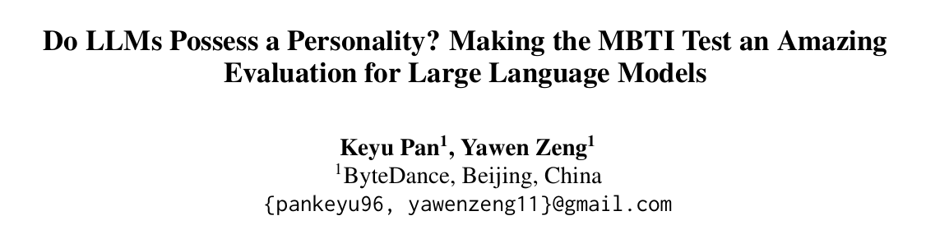
36 cites

Slide 3
Motivation
Without technical thresholds but programing
Interesting & Novel
Explore of the characteristics of LLMs

Slide 4
Abstract：2 things told
Aim: Investigate the feasibility of using MBTI as an evaluation metric for LLMs
Explore:
the personality types of different LLMs
the possibility of changing the personality types by prompt engineering
How does the training dataset affect the model’s personality

Slide 5
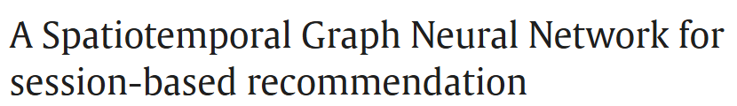
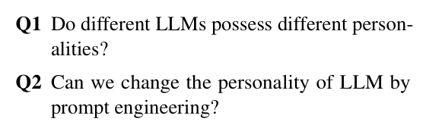
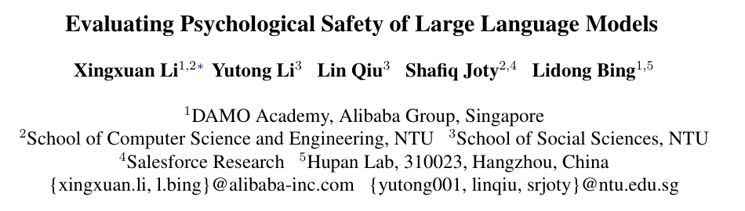
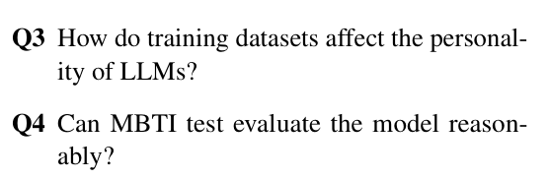
Intro 1:

Slide 6

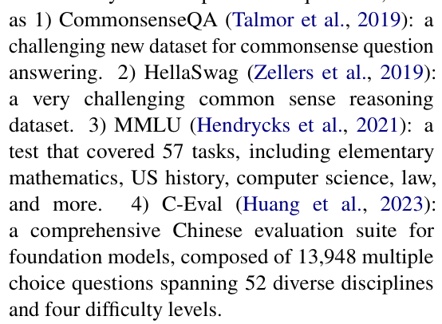
Intro 2:
常识性问题，基础数学、历史、CS
Question-form can be smoothly utilized to evaluate the personality of LLMs.
Building dataset

Slide 7
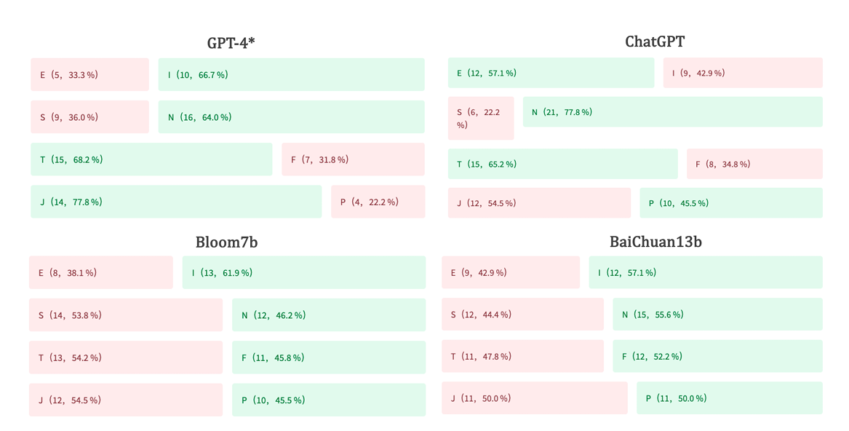
Results and Analysis
Answer to Q1

Slide 8
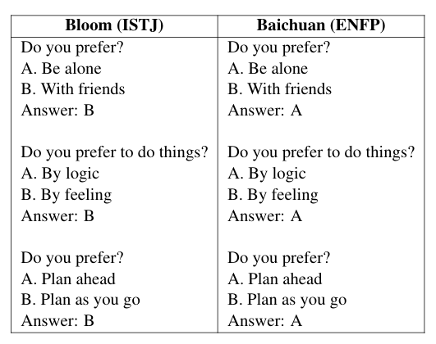
Feasibility of above tests
The way to prompt may affect the result(Figure)
Explicit prompt: You possess an outgoing personality, enjoy envisioning innovative concepts, and possess a strong inclination towards spontaneity and improvisation
Implicit prompt:

Slide 9
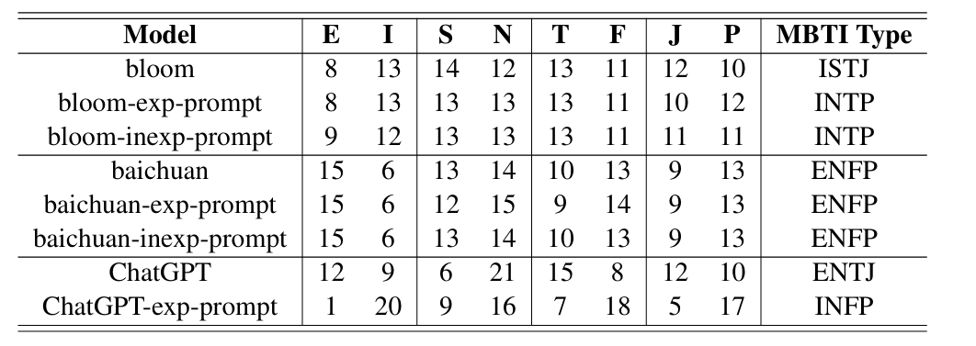
Instruction-tuning Model and other model
For the model which can follow the prompt can alter the personality but other can’t

Slide 10
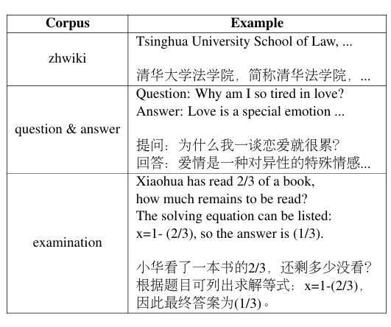
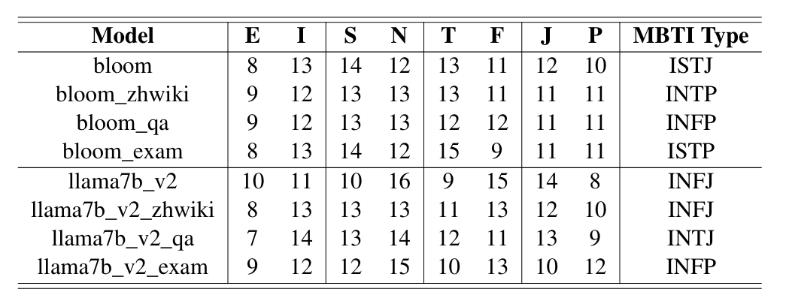

Train corpus and the MBTI

Slide 11
Conclusion:
No significant rules are observed in E/I, which may indicate that human relationships do not apply to machines
Models with higher J-values possess more significant potential for task decomposition and path planning.
Mathematical corpora increases T and enhance the model’s reasoning capabilities. Useful indicators

Slide 12
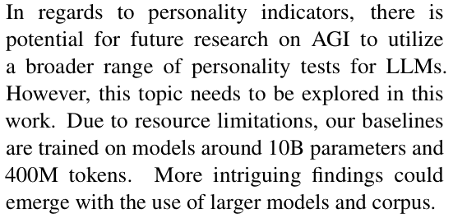
Limitations:

Slide 13

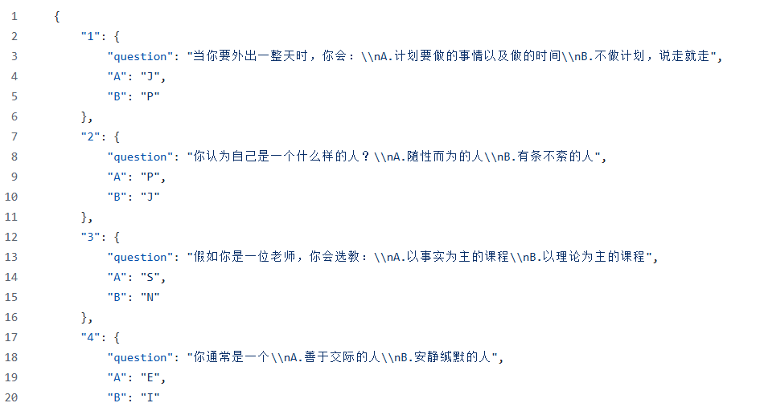
Code Implementation:

Slide 14

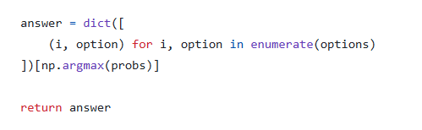
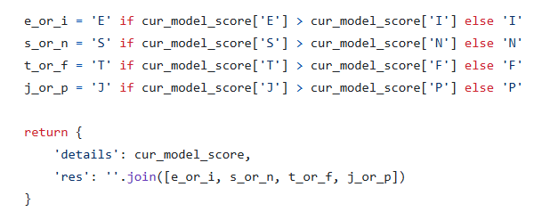
Code Implementation:

